Slide 1
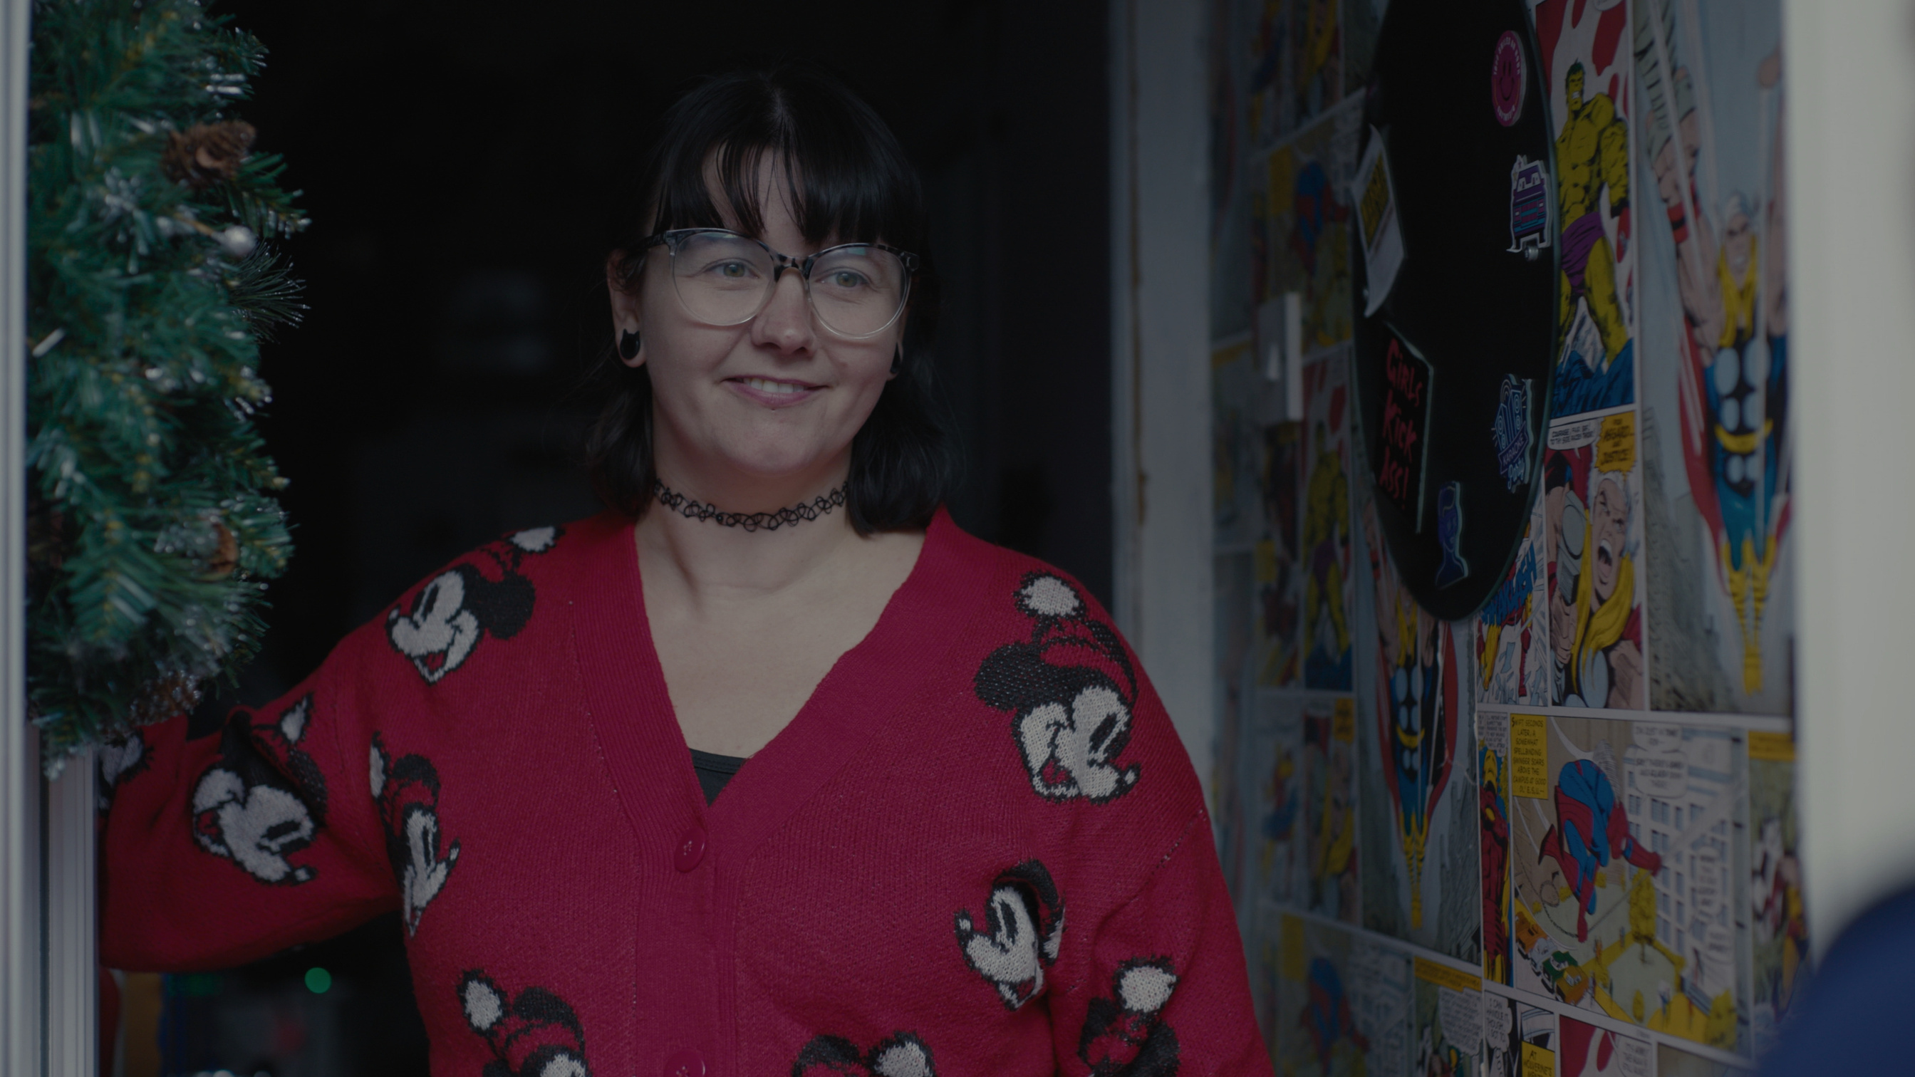
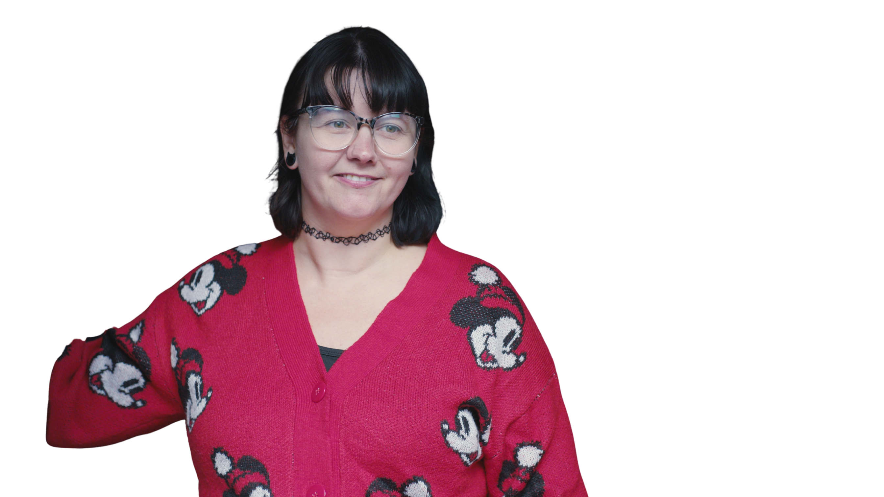






How Spurgeons offers hope to children and families in need
Spurgeons Christmas Appeal 2026
Notes:
This Christmas, we're partnering with Spurgeons to help open doors for families facing challenges.
As we celebrate the birth of Jesus, we remember the first Christmas when a young family arrived at an inn, desperate for somewhere safe for their child, but were met by a closed door and turned away, unwelcome.
Many families today are still struggling, in desperate need, and don't know where to turn for help.
They are looking for that open door, for support, understanding and hope.
Today we'll hear how Spurgeons is helping families find just that and how we as a church can help.

Slide 2



Do not be afraid. I bring you good news that will cause great joy for all the people.
Luke 2:10-11
Notes:
When the angels announced the birth of Jesus, they brought good news for all people.
This Christmas, we remember that message of hope, and think particularly of families who may be facing difficult circumstances, who feel they can't manage alone.
Through Spurgeons, parents and carers can access support when they need it most.

Slide 3
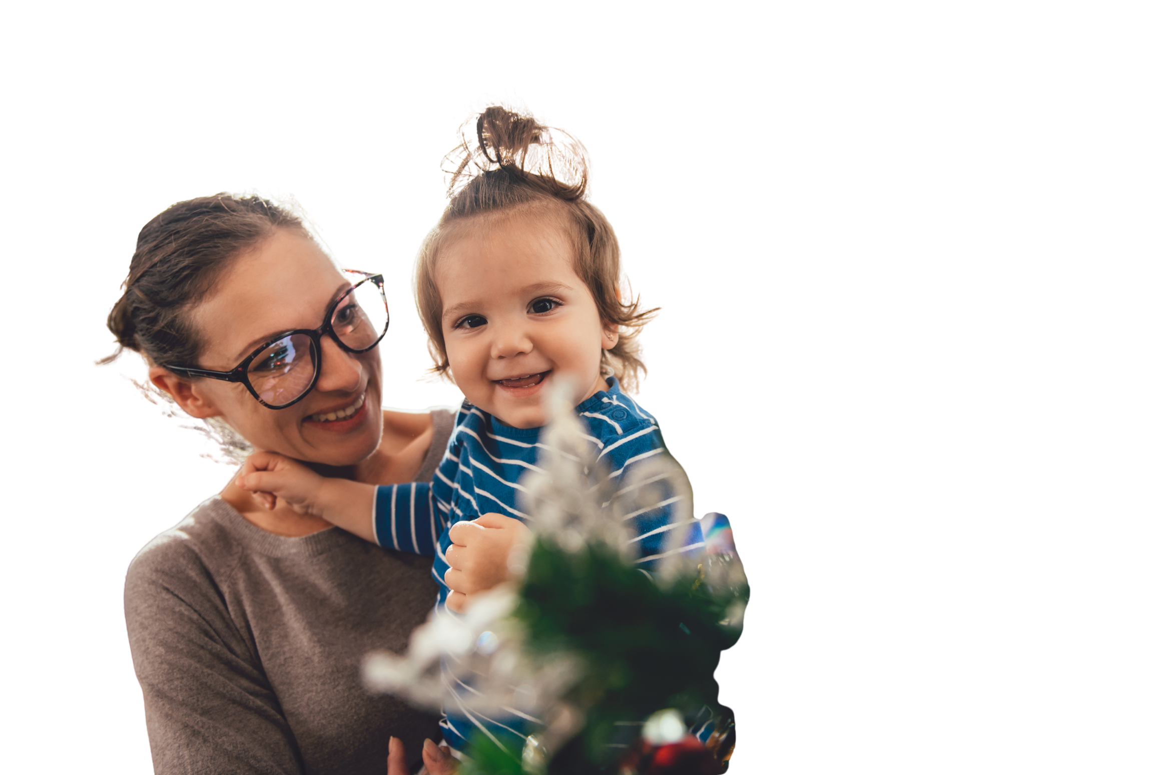








Parents need support too
Many parents face:
Worries about money
Pressures at home
Concerns about their children
Isolation and loneliness
Feeling exhausted and overwhelmed
Many can feel overwhelmed and unsure where to turn
Notes:
Many parents are carrying burdens that others never see.
Parents may be struggling with money worries, pressures at home, concern for their children, loneliness and isolation, anxiety, and many other concerns.
Many feel overwhelmed and unsure where to turn or how to move forwards.

Slide 4
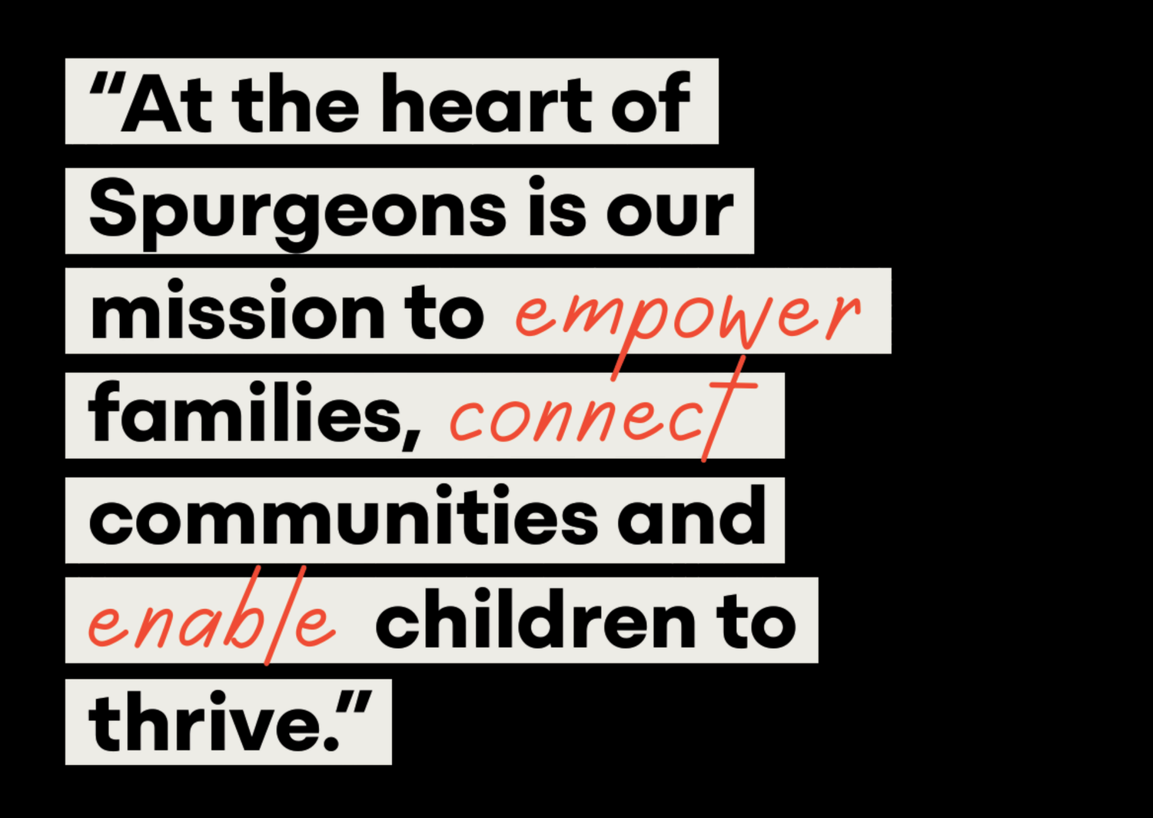
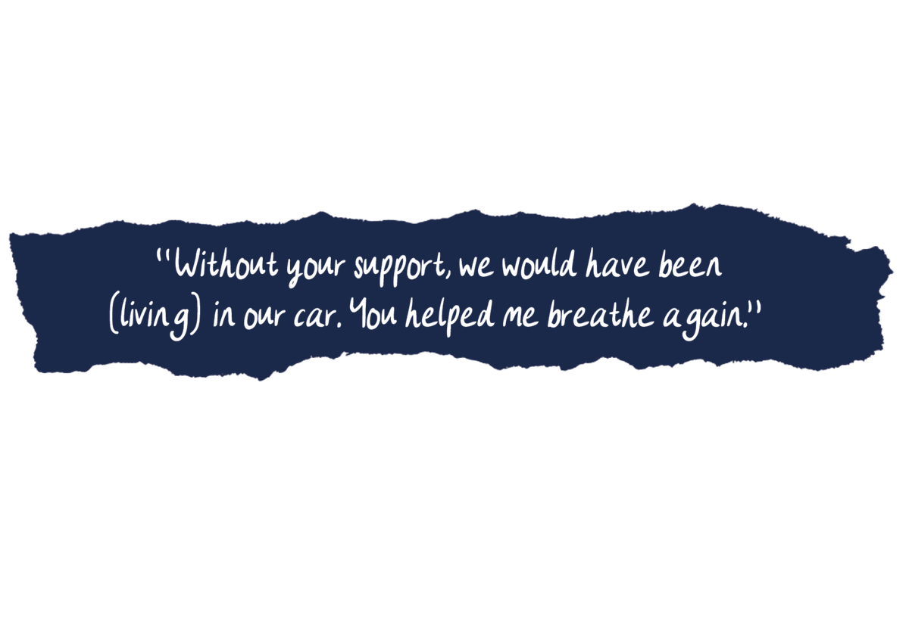
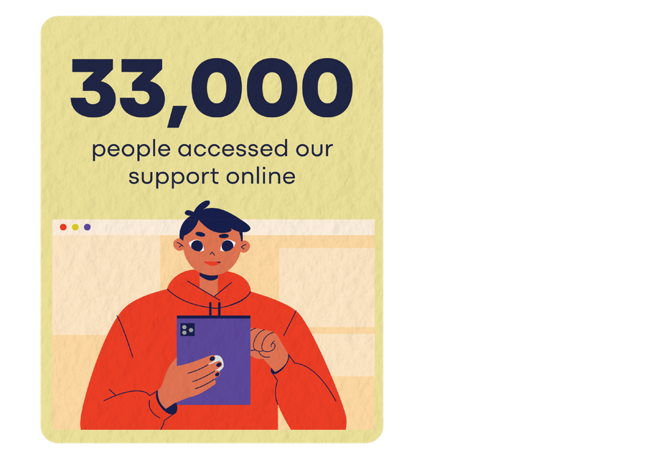
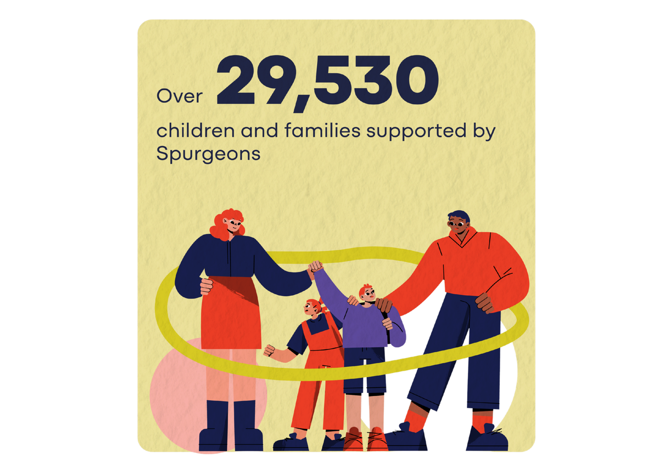
Spurgeons impact last year
Notes:
Every day, Spurgeons walks alongside children and families facing some of life's toughest challenges.
Through family support, counselling, community based family hubs, support for children affected by parental imprisonment, and practical resources on their Digital Family Hub, Spurgeons is there when families need someone to turn to.
Last year, Spurgeons gave more than 29,500 children and families direct support, while a further 33,000 people accessed online help and resources.
Behind every conversation, visit and resource is a family looking for hope.
One parent summed up the impact of that support in this quote:
"Without your support, we would have been living in our car. You helped me breathe again."
Those words remind us that this work is about far more than providing a service. It's about helping people find hope, strength and a way forward when they feel they can no longer cope alone.
One of those families was Carrie's.

Slide 5
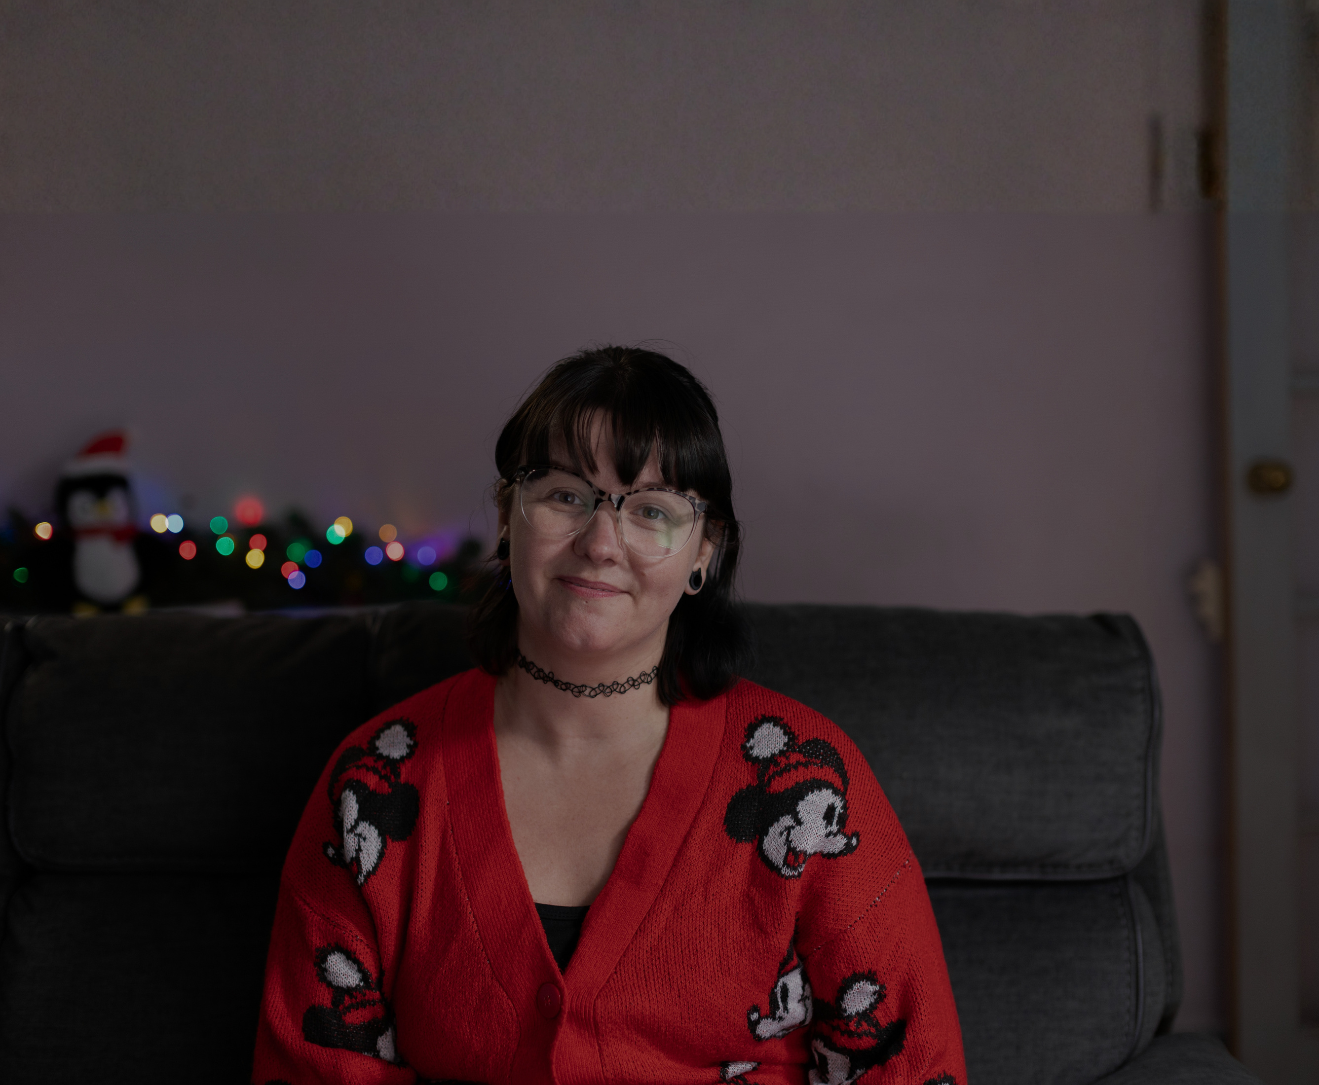
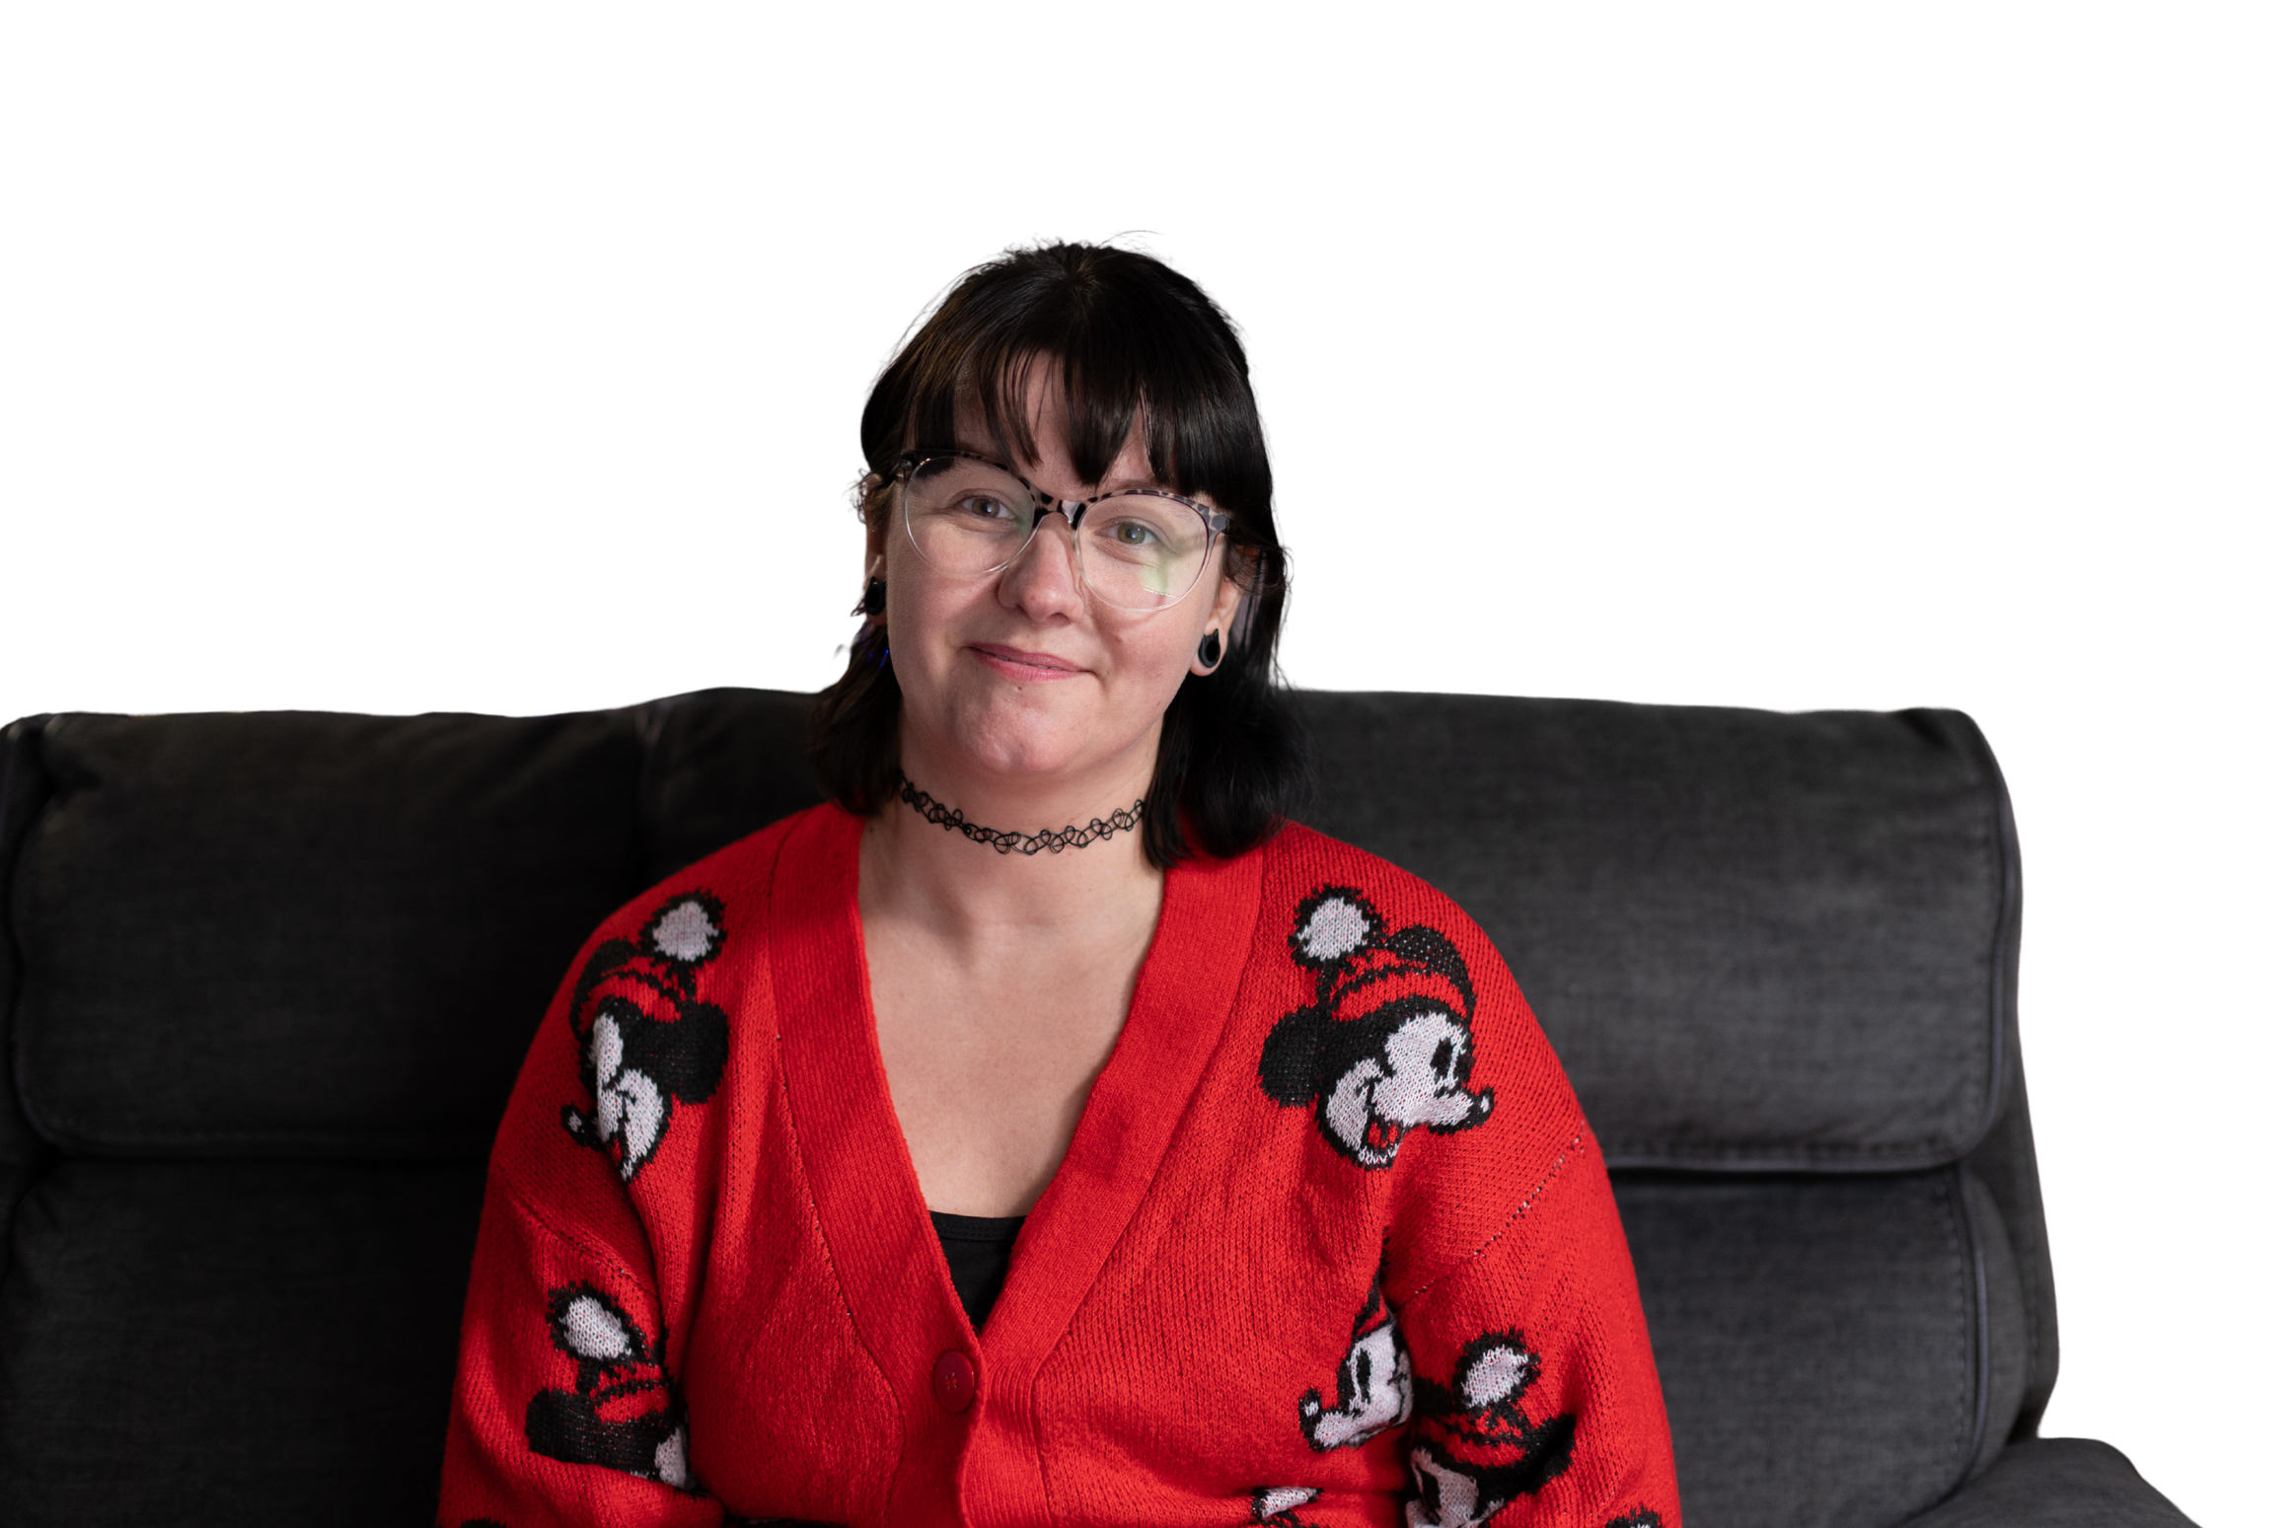
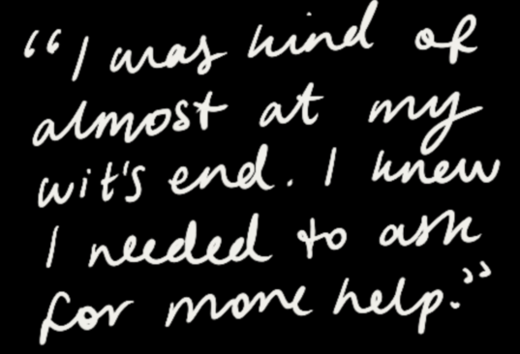
Carrie’s story
Notes:
Carrie's story reflects the experience of many parents Spurgeons supports.
As a devoted mother of two autistic children, she was doing everything she could to meet their needs. But over time, the pressures became overwhelming. She was exhausted, struggling to cope, and unsure where to turn for help.
Eventually, Carrie reached a point where she knew she couldn't manage alone. As she puts it, "I was almost at my wit's end. I knew I needed to ask for more help."
[This is where we recommend playing the video, if you are able]

Slide 6
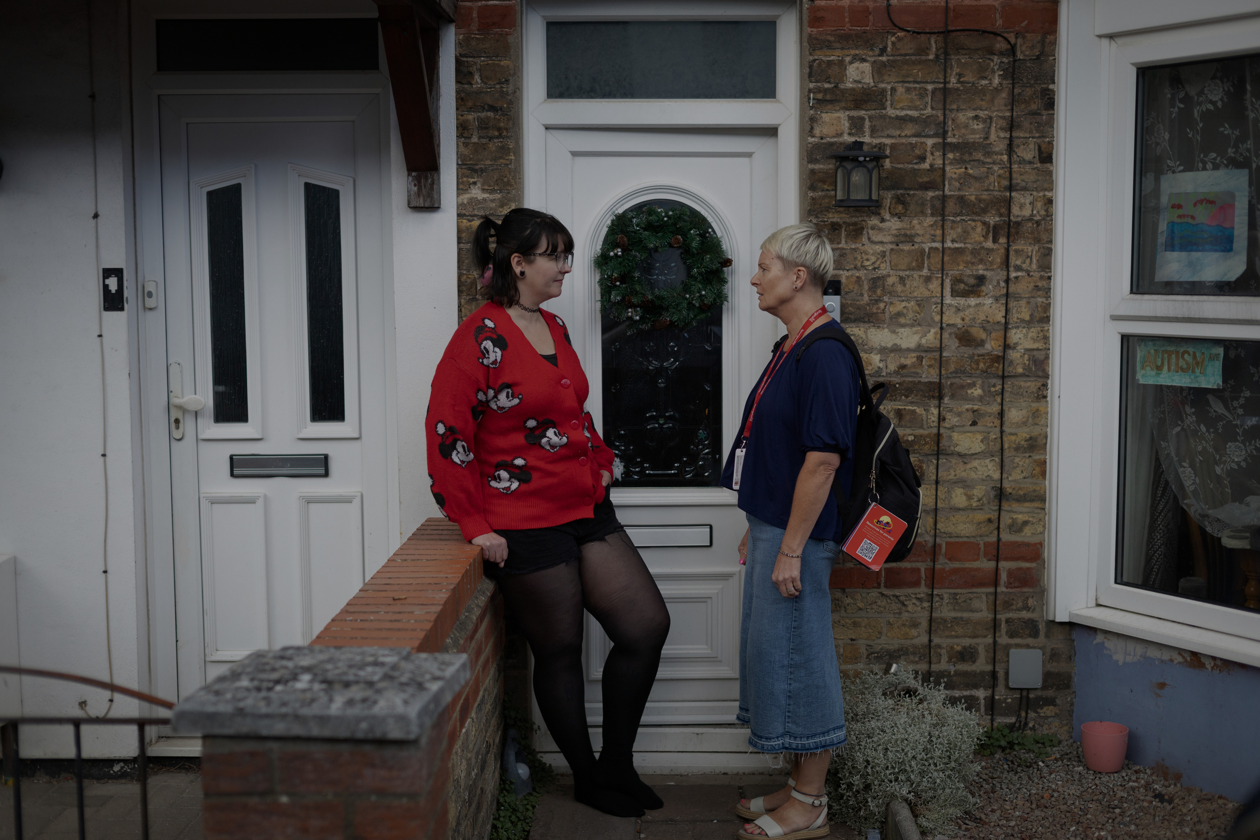
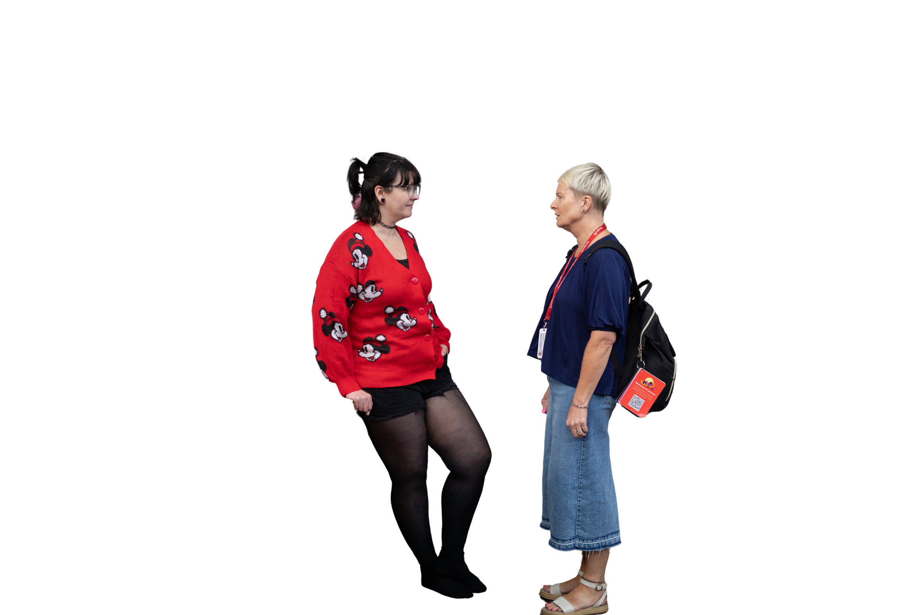
Carrie’s story
An open door to support
Jane, a Spurgeons Family Practitioner, took time to listen and understand what daily life was really like.
Together, they:
  explored the family’s challenges
  developed practical coping strategies
  built Carrie’s confidence as a parent
Little by little, family life became more manageable.
Notes:
Carrie was connected with Jane, a Spurgeons Family Practitioner who took time to understand what life was really like for her family.
Together, they explored the challenges she was facing, identified practical ways to support her children, and developed strategies that could make everyday life more manageable.
Little by little, things began to change. Carrie grew in confidence, family life became more stable, and she felt better equipped to support her children through the challenges they faced.

Slide 7

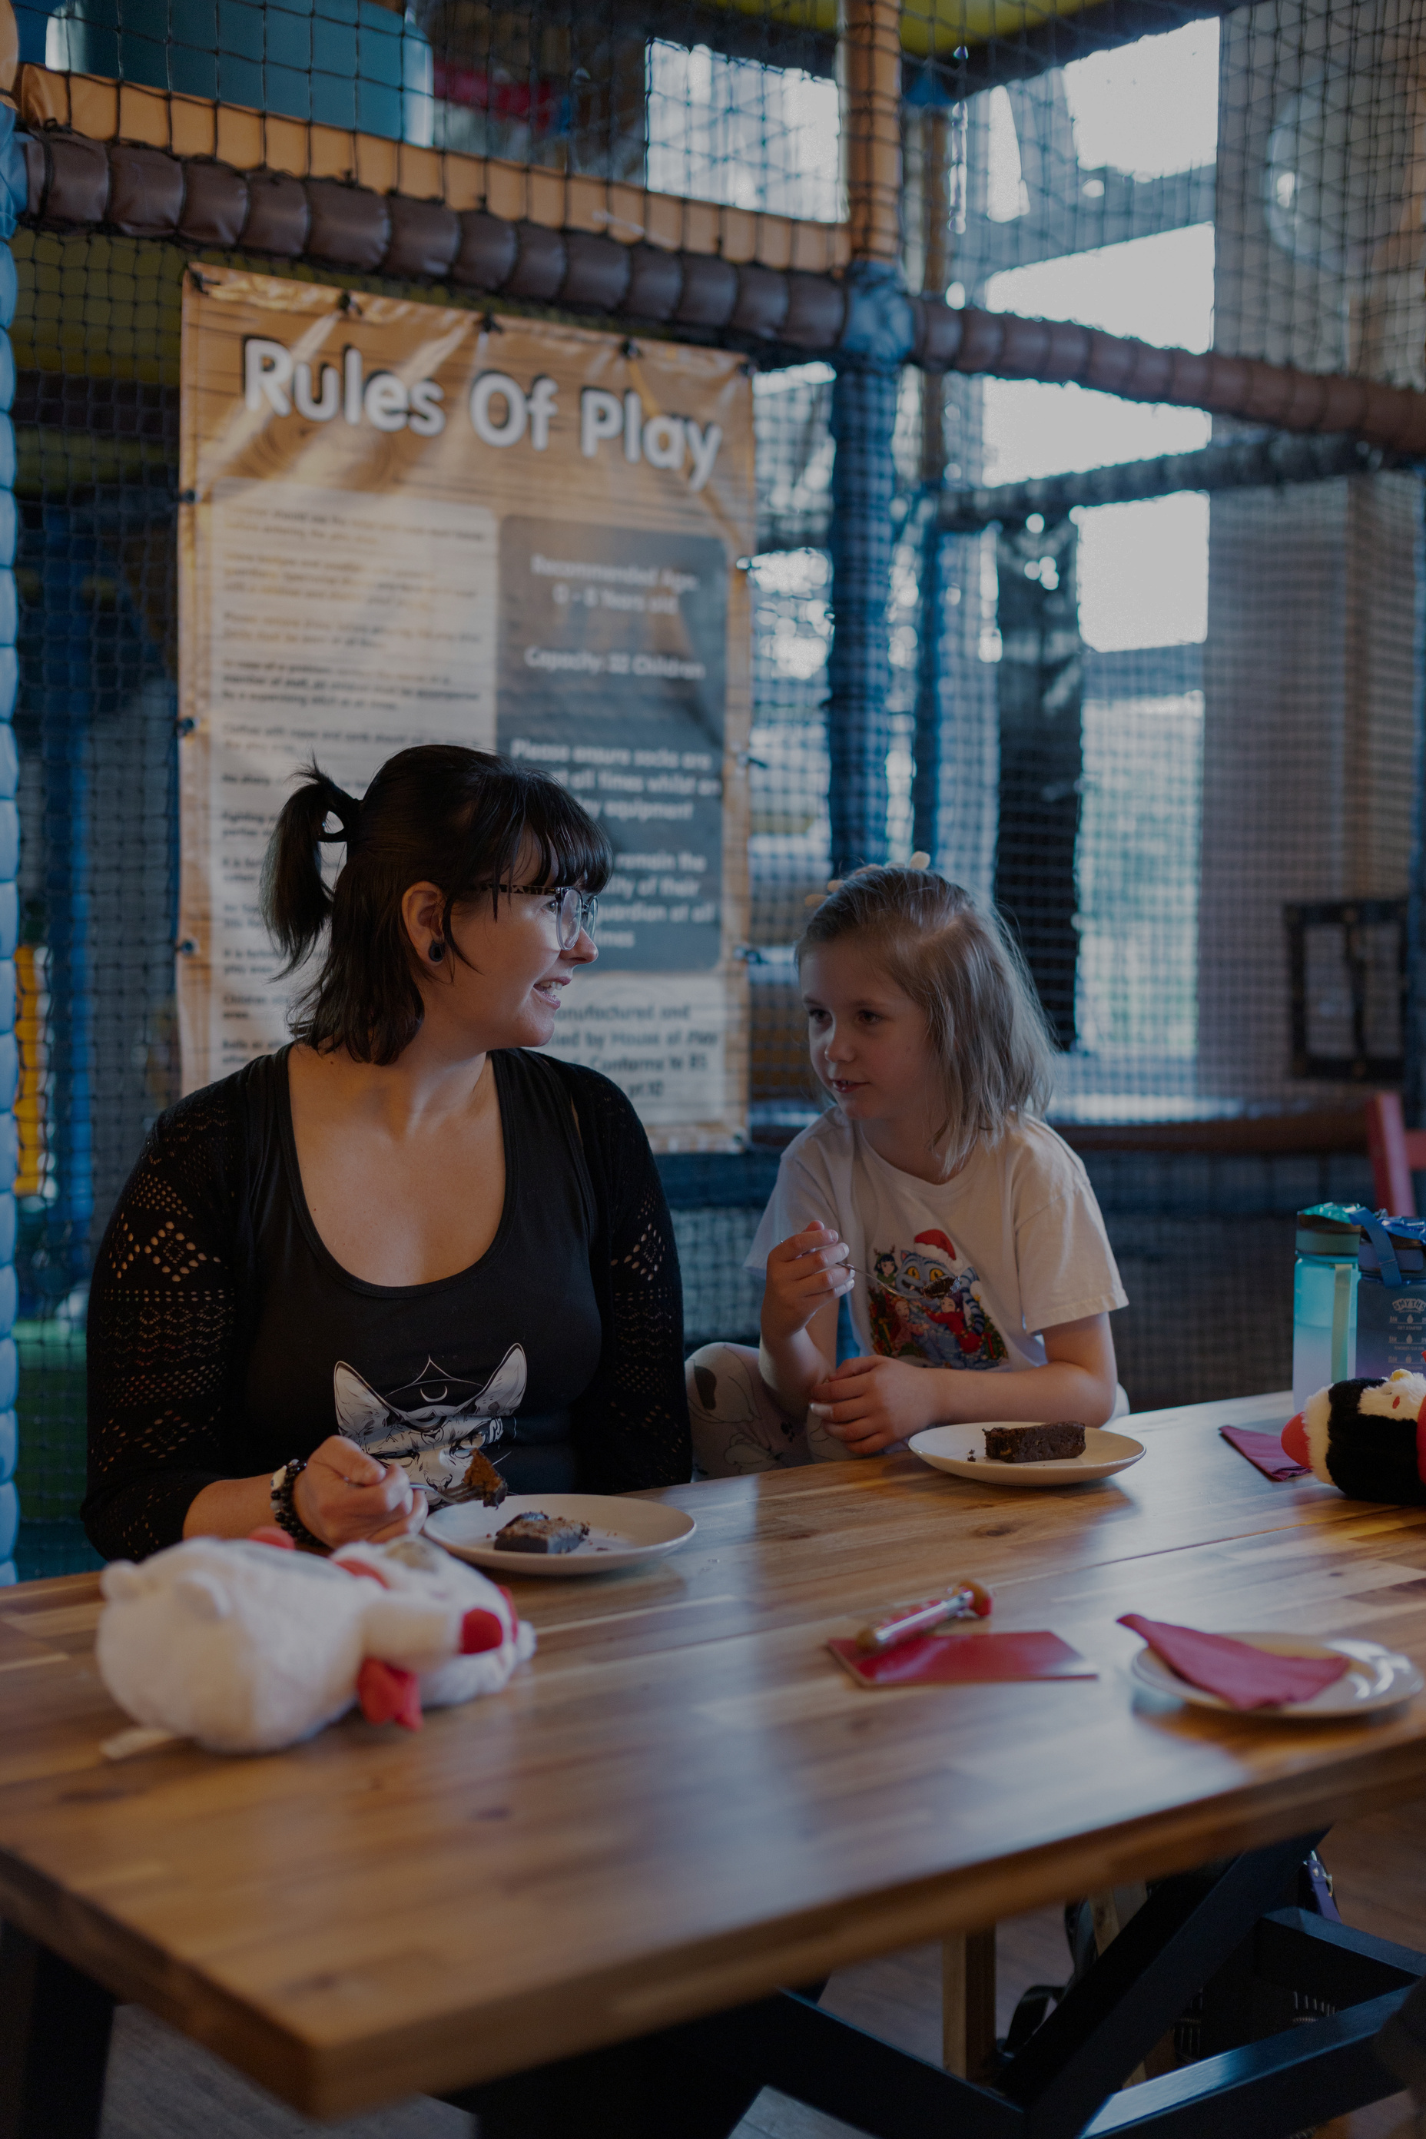
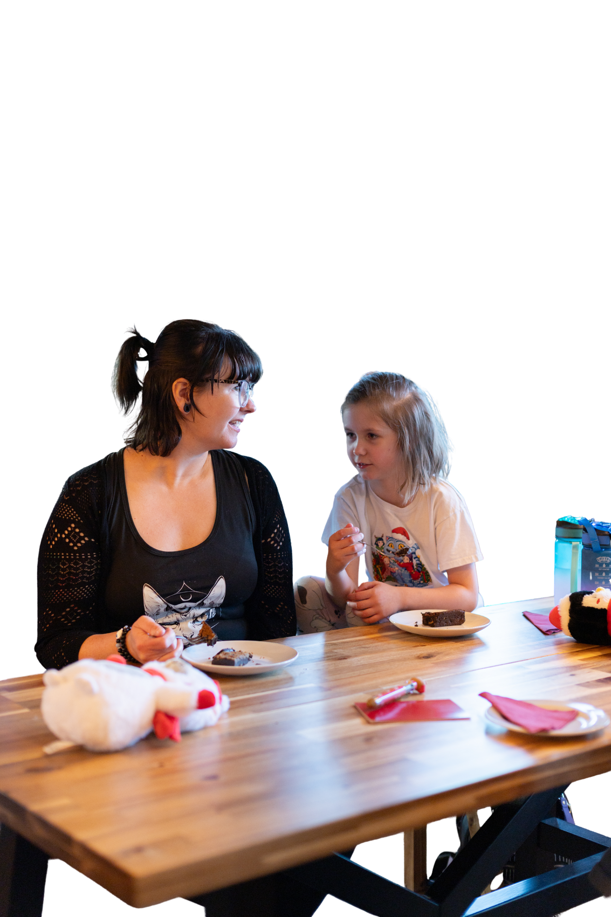
Every family deserves somewhere to turn
At Spurgeons, we:
  Listen without judgement
  Offer support when life feels overwhelming
  Provide guidance through everyday challenges
  Build confidence to move forward
Notes:
Carrie's story is just one example of the difference Spurgeons support can make.
The right support at the right time can make all the difference. It can help parents build confidence, strengthen family relationships and create confidence, stability and a brighter future for their children.

Slide 8

Together, we can open doors to practical support, confidence and hope.
Notes:
When we partner with Spurgeons through prayer, generous giving and by supporting families in our community, we can also help to transform lives.

Slide 9
Help open the door to hope
How many doors can we open through our generosity?
£124
could open the door to expert support and a personalised action plan
£500
could open the door to ongoing support to help rebuild a family’s confidence and stability.
£745
could open the door to specialist support for a family facing complex SEN or trauma related challenges.
Notes:
This Christmas, we want to help Spurgeons open the door to hope for more families like Carrie's.
Our gifts can help provide the practical support, expert guidance, and ongoing encouragement that families need to move forward.
The examples on screen show how, together, we can help families access advice, guidance and practical support through Spurgeons' Family Support Service.

Slide 10
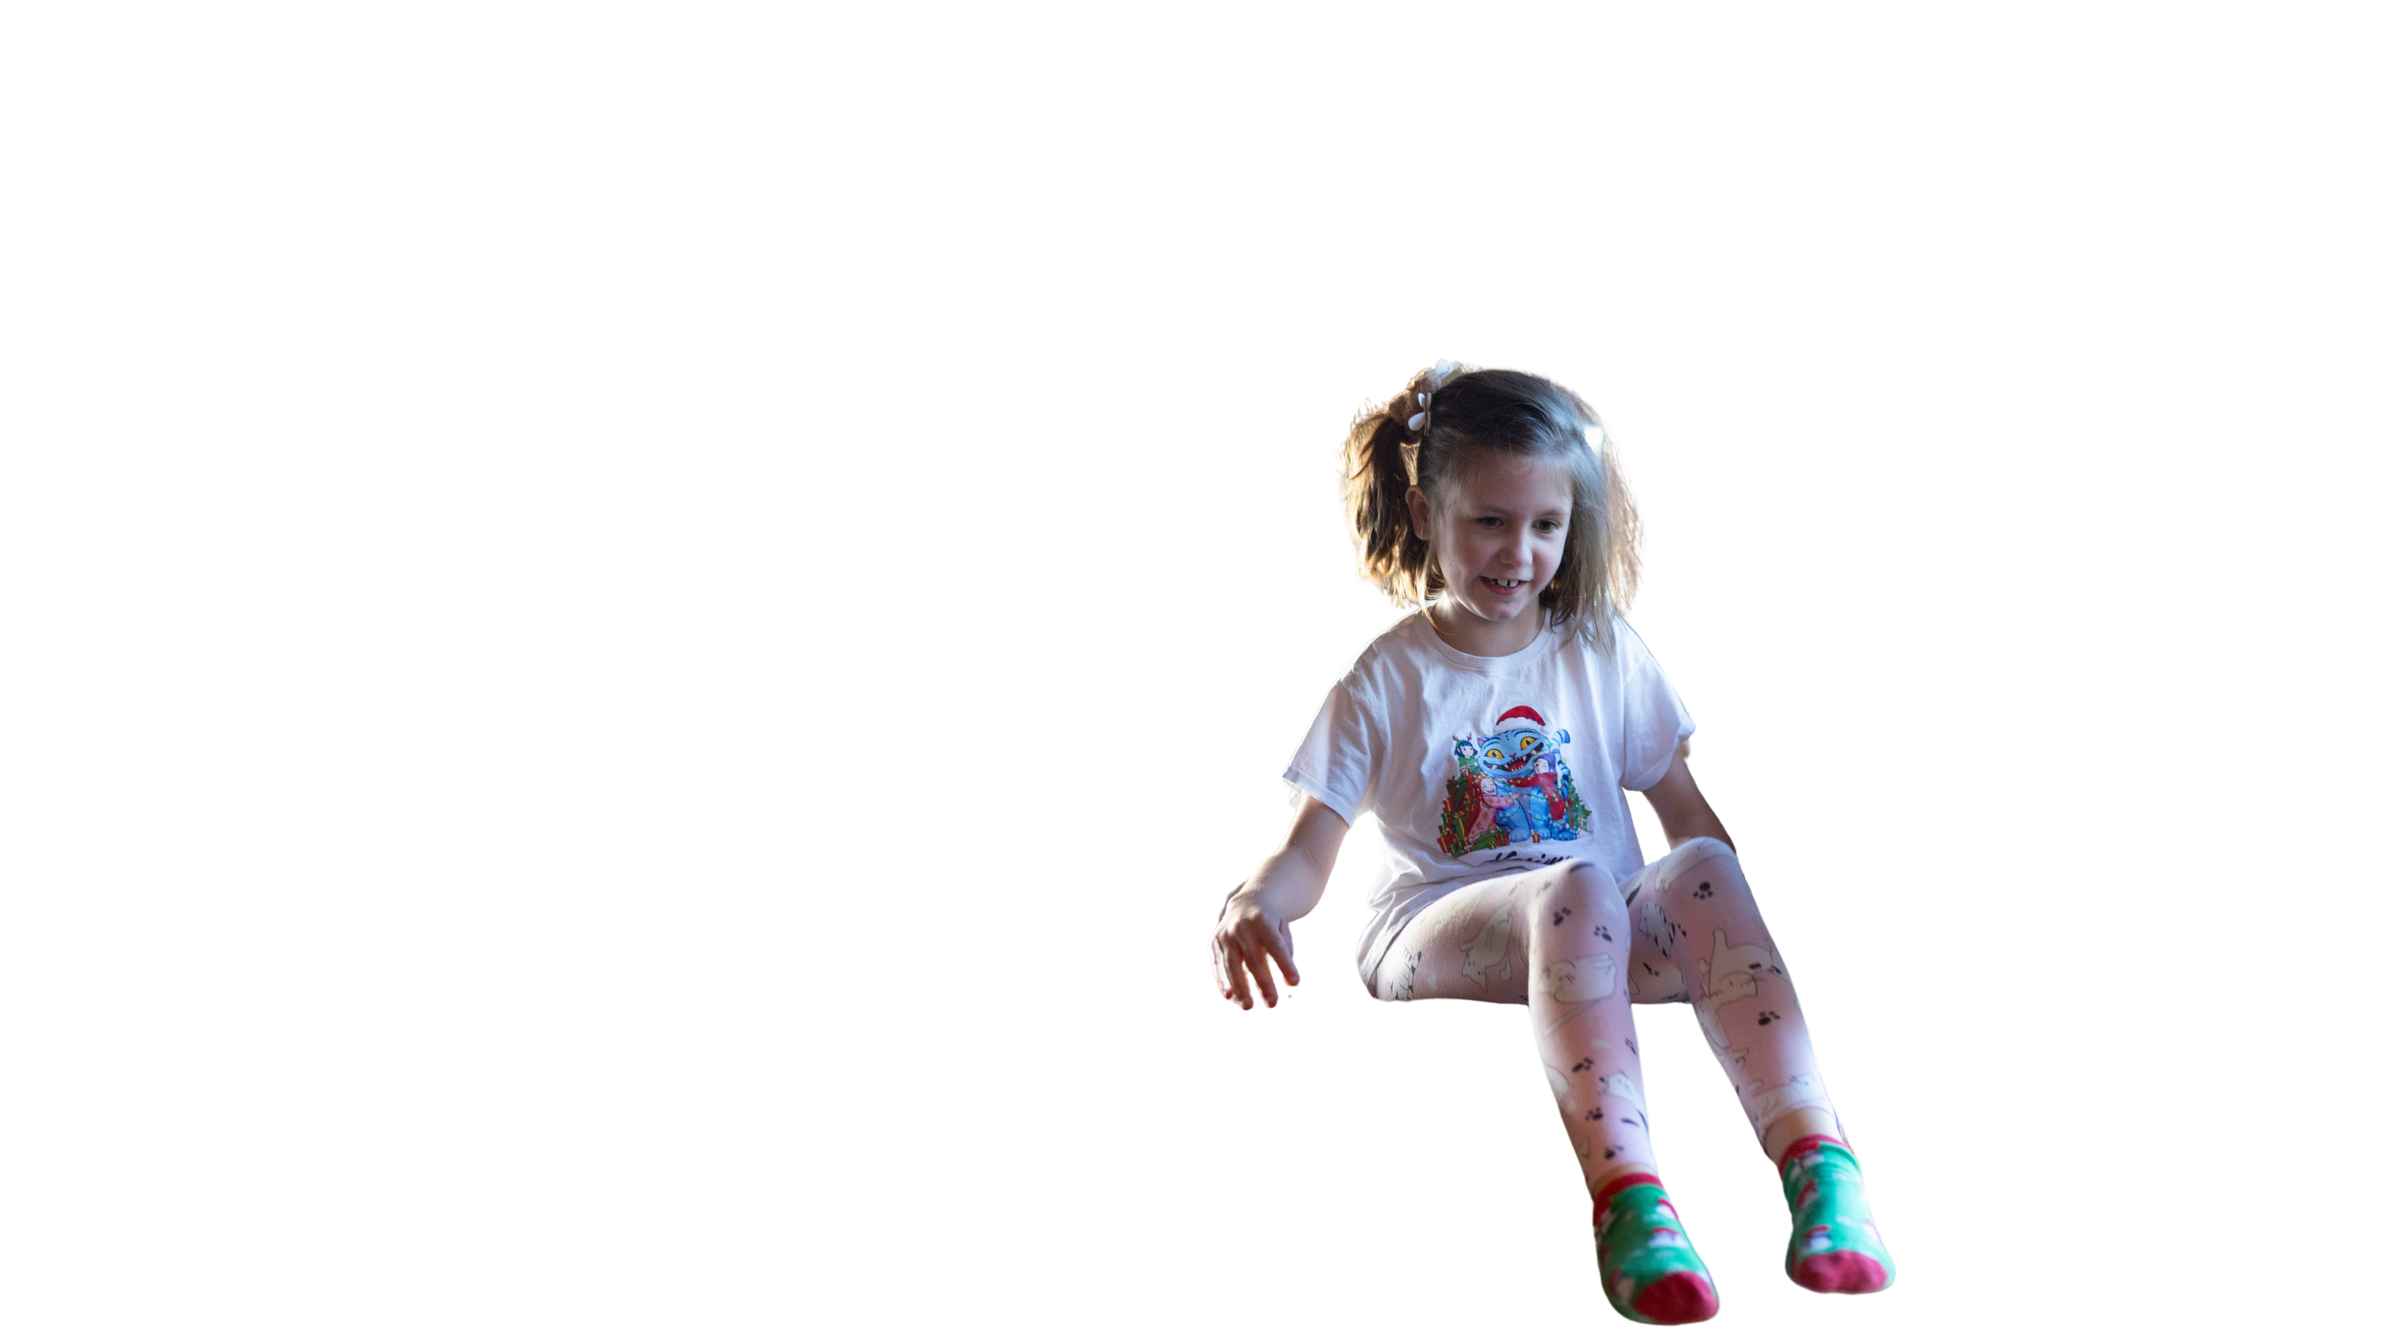
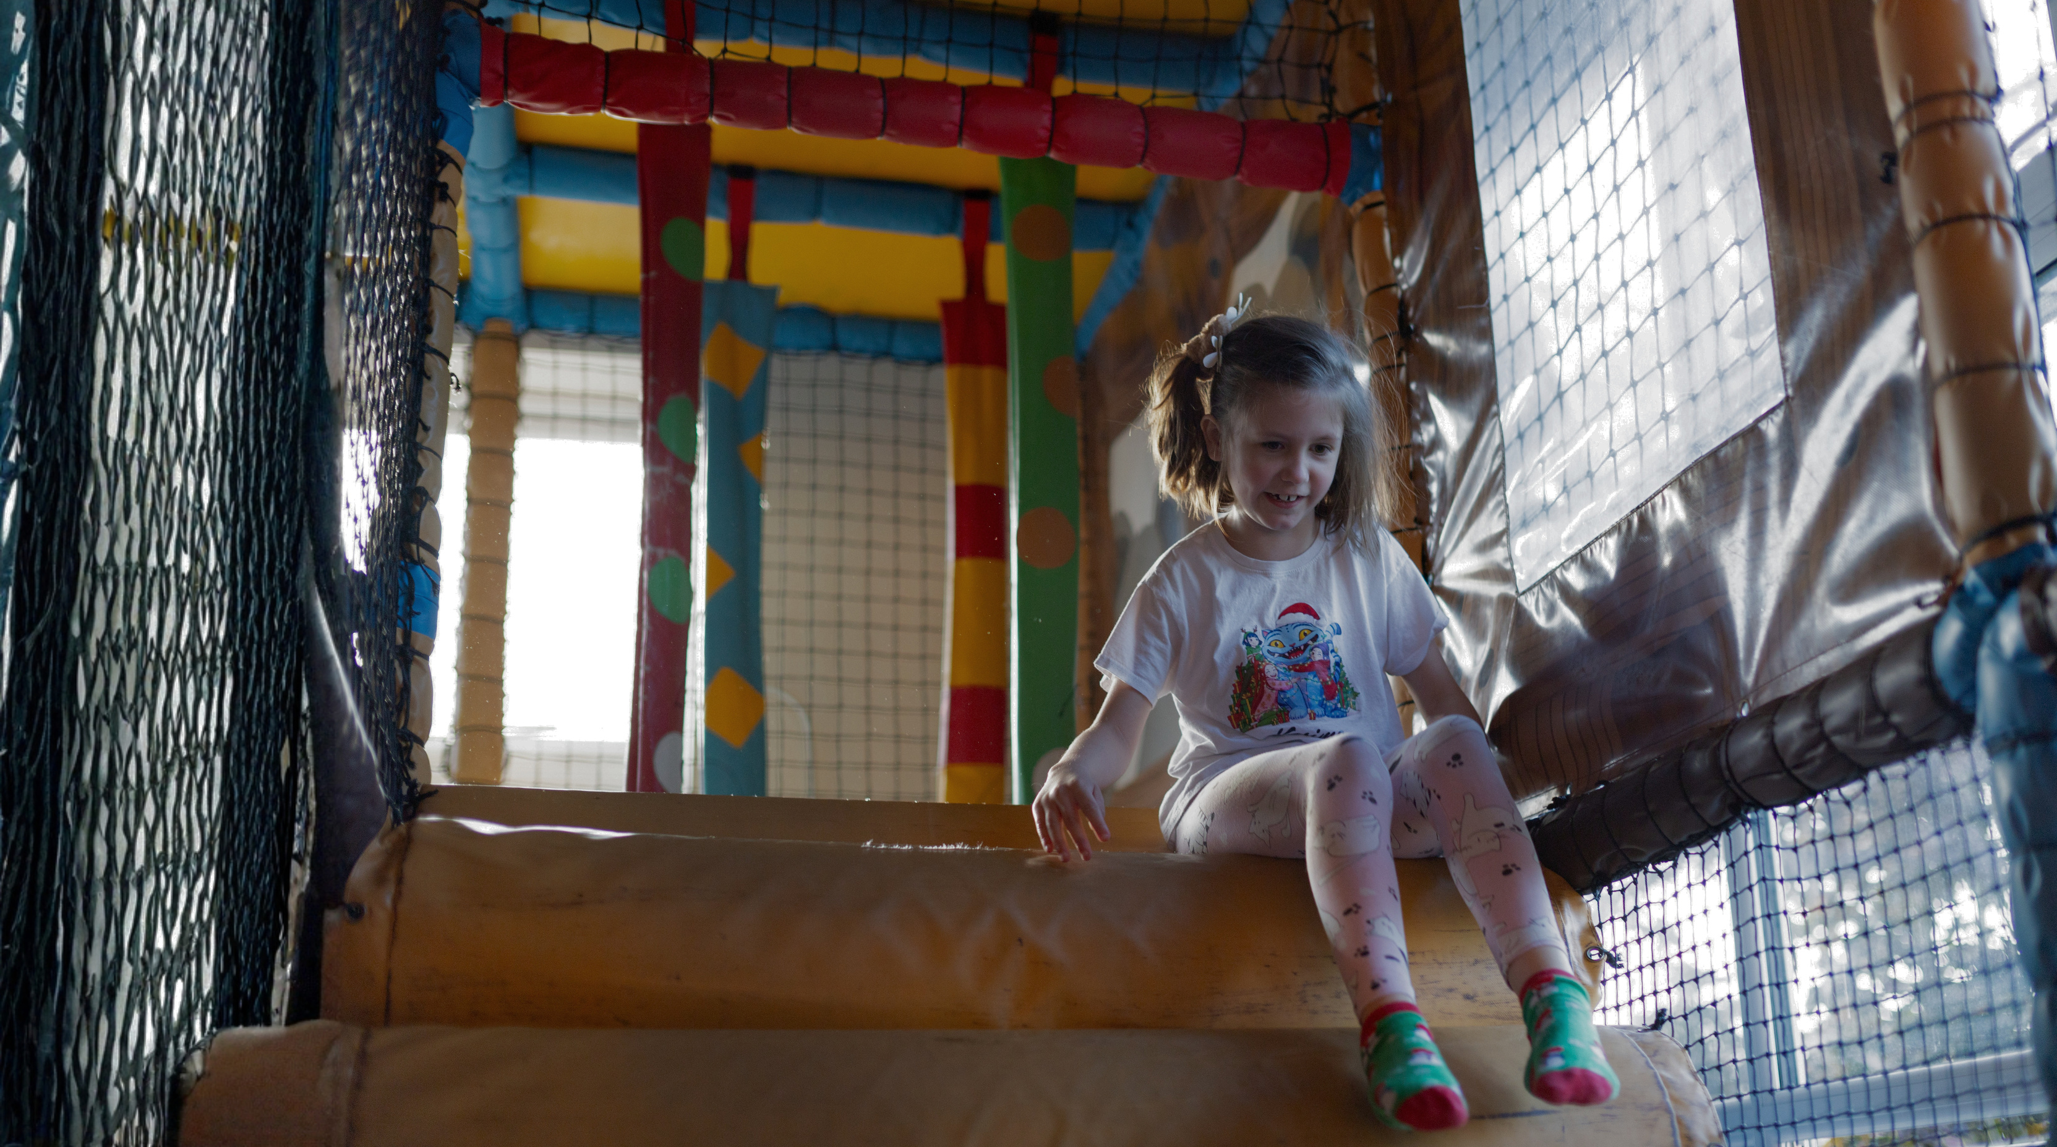
Thank you for your support.
Together, we can help more children and families find hope, strength and the support they need to flourish.
Notes:
This Christmas, we're reminded that God welcomes us with open arms and offers hope in every season.
If you're able to give today, your generosity will help more families access life-changing support and experience hope for the future.
Together, we can play our part in opening doors and sharing God's love with families who need it most.
Thank you for helping to be the welcome every family deserves this Christmas.

